Slide 1

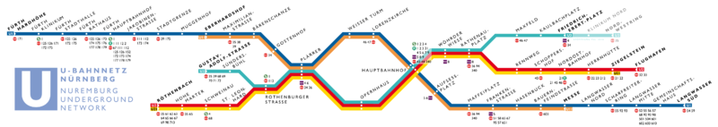
Networked Me
Question:
What networks do you belong to or use?
http://en.wikipedia.org/wiki/File:U-Bahn_N%C3%BCrnberg_Linienband.png

Slide 2
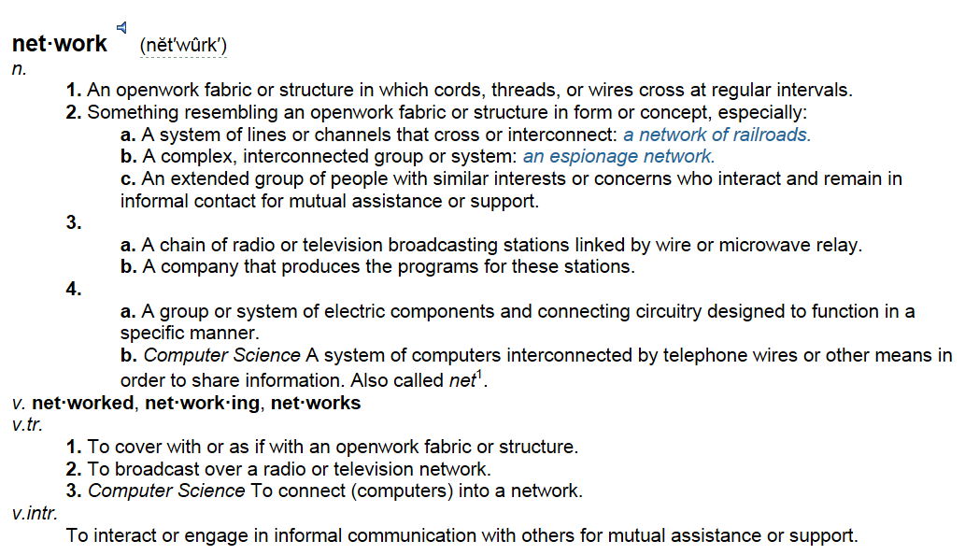
What is a network?
http://www.thefreedictionary.com/network

Slide 3


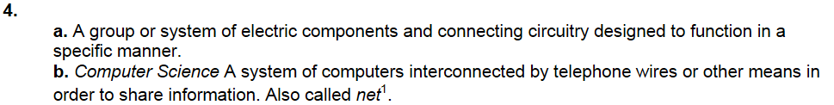

What is a network?
http://www.thefreedictionary.com/network
Images from pixabay.com

Slide 4
Networks and you
Hand out 1
List the major parts of your typical weekday:
Any networks you connect or belong to?

Slide 5
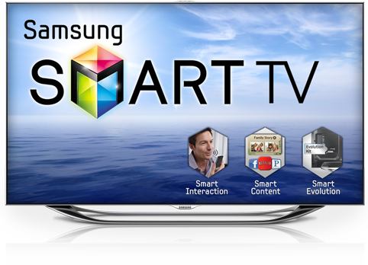

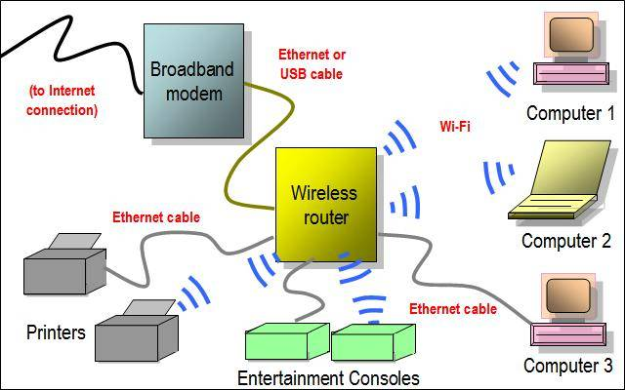
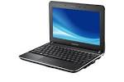
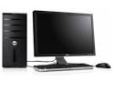



A well-connected home set up

Slide 6
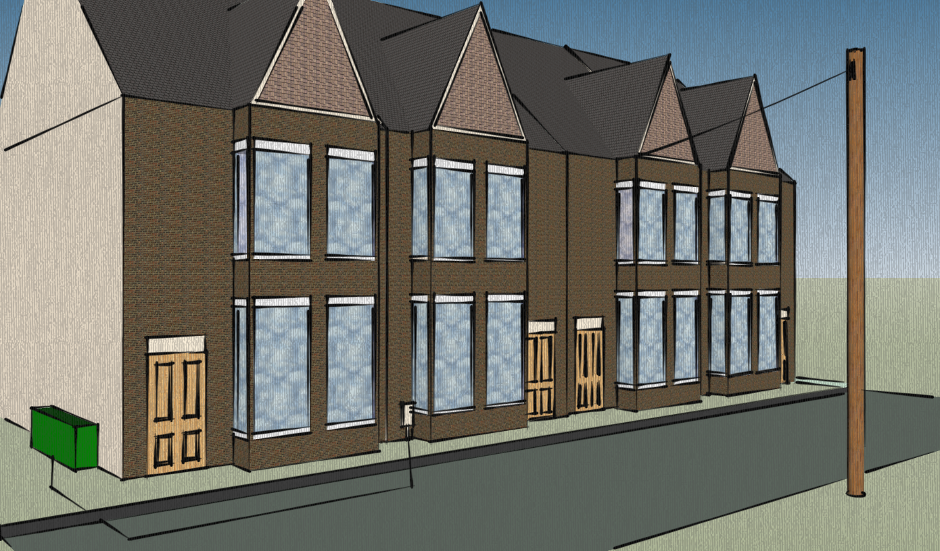
Connecting a house

Slide 7
Networks—Ever heard the word?
Hand out 2
Word | Never | Yes but can't explain | Explanation
Computer Network | ⃝ | ⃝
Social network | ⃝ | ⃝
Router | ⃝ | ⃝
Modem | ⃝ | ⃝
Wi-fi | ⃝ | ⃝
Ethernet | ⃝ | ⃝
Session | ⃝ | ⃝
Domain | ⃝ | ⃝
DNS | ⃝ | ⃝
URL | ⃝ | ⃝
I.P. Address | ⃝ | ⃝

Slide 8
Networks—Ever heard the word?
Hand out 2
Word | Never | Yes but can't explain | Explanation
Computer Network | ⃝ | ⃝
Social network | ⃝ | ⃝
Router | ⃝ | ⃝
Modem | ⃝ | ⃝
Wi-fi | ⃝ | ⃝
Ethernet | ⃝ | ⃝
Session | ⃝ | ⃝
Domain | ⃝ | ⃝
DNS | ⃝ | ⃝
URL | ⃝ | ⃝
I.P. Address | ⃝ | ⃝

